Slide 1

BESTBUY Case Study
Team member: Bingbing Pan, Harsh Tandon, Tianqing Feng

Slide 2
Introduction- Business question
What are the customer attributes correlated with a high propensity to purchase the geek squad protection plan?
What is geek squad protection plan?
Geek Squad Protection Plans are an optional form of product coverage that provide additional value to BestBuy customers. It also provides additional coverage when manufacturer warranties come up short.

Slide 3
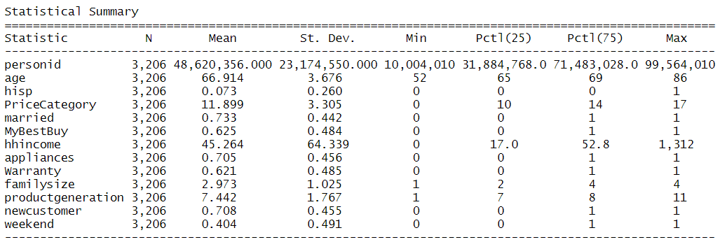
Introduction- Dataset
The dataset, named “BestBuy.csv” includes 3,206 transactions made in March 2017 and only from Santa Clara Best Buy stores.

Slide 4
How do we solve it?
Summary of dataset (correlation)
Methods we used: Binary Logit and Random Forest
Model Comparison
Result of Binary logit
Model Visualization
Recommendation

Slide 5
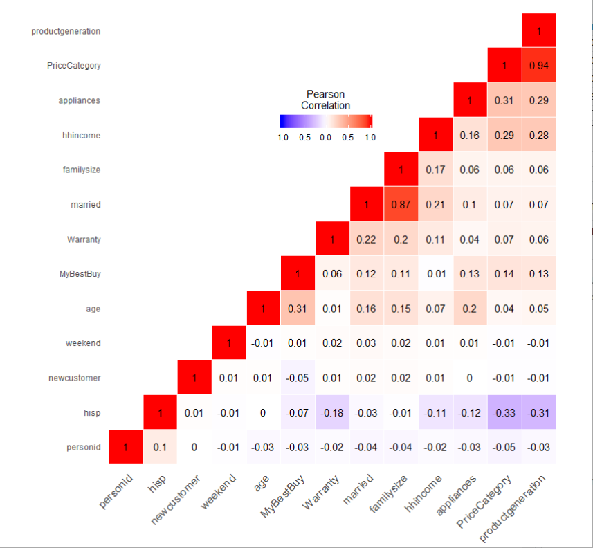
Variable Choices
Price Category & Product generation
Highly Correlated
Married & family size

Slide 6
Binary Logit and Random Forest
Binary Logit
When you target variable is binary.
Provide insights into importance of each variable
When you want a quick initial benchmark.
Random Forest
An ensemble method that uses several independent decision trees to work together.
Performance is usually better.

Slide 7
Model Comparison
Binary Logit vs. Random Forest
Accuracy: 67.71%
AUC Score: 63.75%
Accuracy: 66.61%
AUC Score: 61.18%

Slide 8
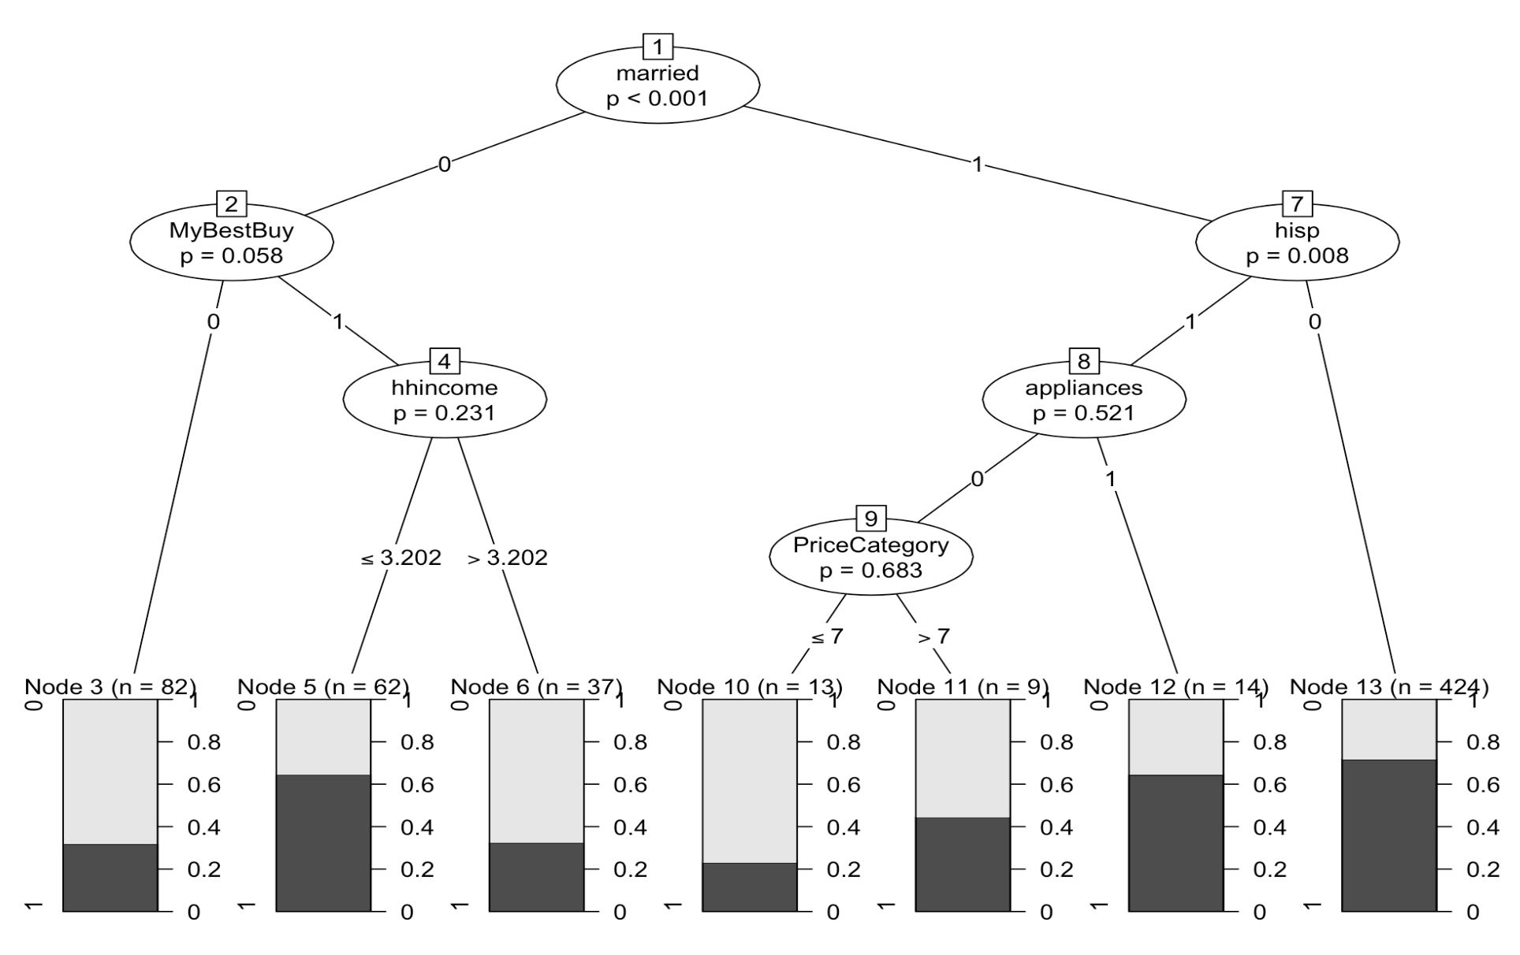
Result of Random Forest Model

Slide 9
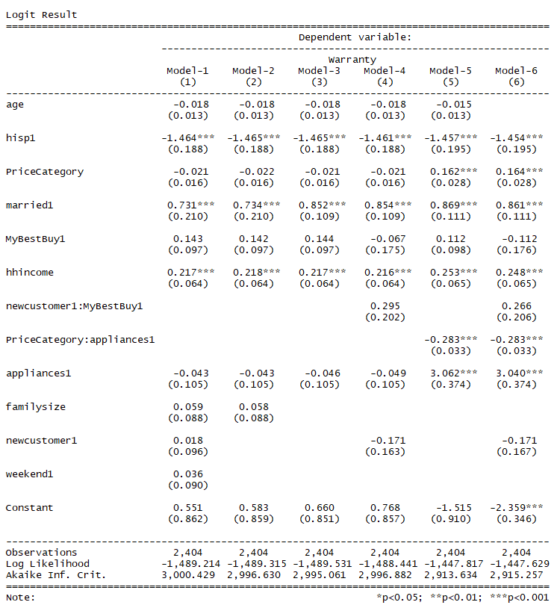
Result of Binary Logit Models
Significant features:
Hispanic
Married
Household income
Price Category X Home Appliance
AIC: 2913.634

Slide 10
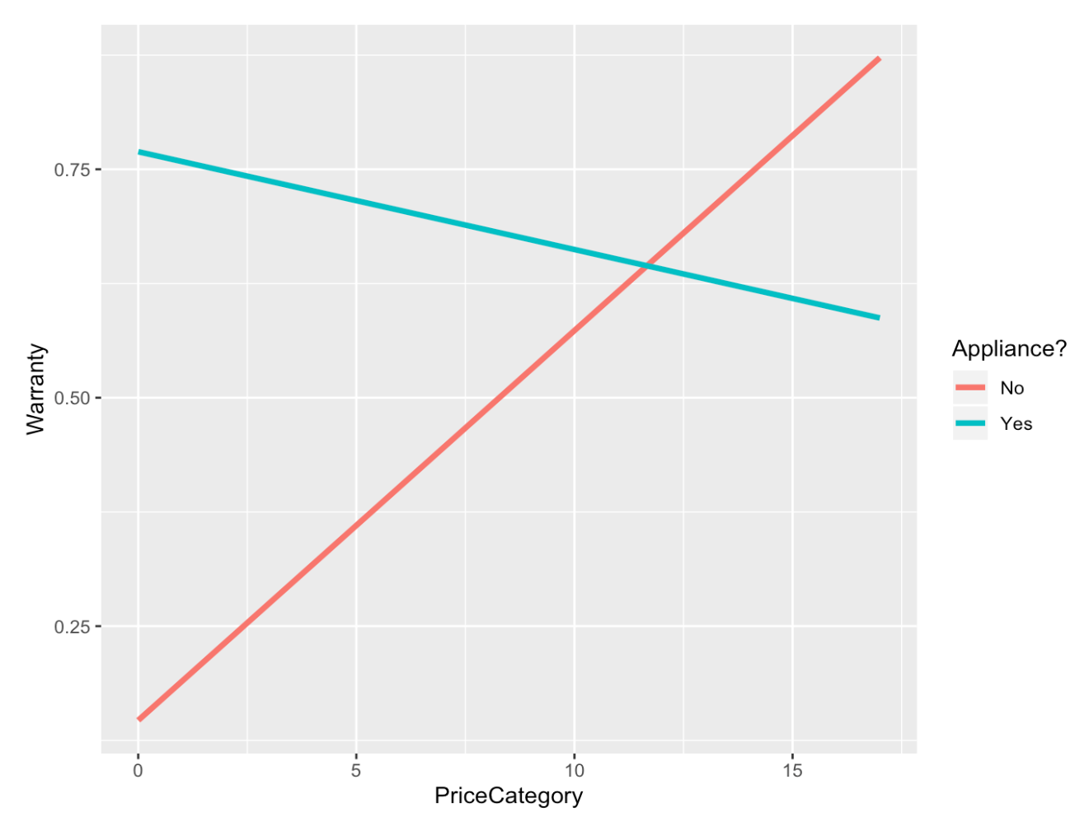
Model Visualization

Slide 11
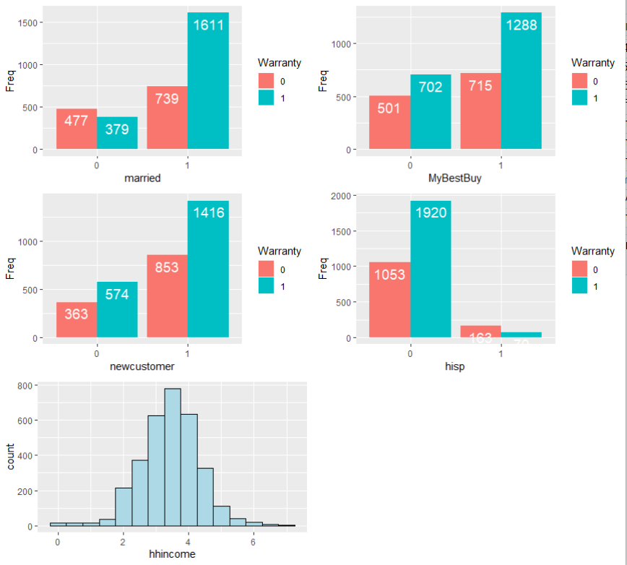
Model Visualization

Slide 12
Recommendation
Target Customers group:
Married
MyBestbuy Credit Card Owners
New customers
Customers who have medium household income
None Hispanic
Purchase home appliance with relatively low price
Purchase non-home appliance with relatively high price

Slide 13
Limitation & Improvement
Limited data size
Age variable is skewed to the left (52 years to 86 years old)
Information on Gender is not available
Customer preference information is not available

Slide 14
Question?

